Slide 1
Object Oriented Programming – OOP

Slide 2
Object Oriented Programming
OOP Principles
Objects. Classes
Constructors
Data encapsulation
Inheritance
Polymorphism
Abstraction
Coupling and Cohesion

Slide 3
OOP Principles
Abstraction
Means hiding lower-level details and exposing only the essential and relevant details to the users.
Encapsulation
Hides information from the users of a class.
Uses access modifiers (public, protected, private).
Inheritance
Allows a derived or child class to use parts of a base or parent class.
Uses the extends keyword.
Polymorphism
Technique which supports different behavior of methods that is dependent on the object the method is executing against.
Overloading / Overriding methods

Slide 4
Objects. Classes
Class
A blueprint or prototype (template) from which objects are created.
Object
An instance of a class
states (variables, properties)
behaviors (methods, functions)

Slide 5
Object creation
new keyword
Memory is allocated for the new instance of the class
A constructor is called to perform initialization of the object
A reference to the object is returned
Employee employee = new Employee();
Each instance of a class has its own set of instance variables that are independent of each other
The class’ methods are shared among the instances of the class (there is only one copy of the methods)
Notes:
Declaration of an object
Instantiation of an object

Slide 6
Constructors
Constructors are special methods that create and return an object of the class in which they’re defined.
They have the same name as the name of the class in which they’re defined.
They do not have a return type.
Constructors can:
Call the base class’ constructor
Initialize all of the instance variables of a class with their default values
Types:
Default constructors
User-defined constructors
Notes:
What access modifiers can have a constructor?
What happens if we define a return type for a constructor?

Slide 7
Default Constructors
Default constructor
A default constructor is a constructor that has no arguments.
If a class does not have any constructors explicitly declared, it automatically has a default constructor.
If the programmer adds a constructor to the class (user-defined constructor), then the class will no longer have a default constructor added automatically.

Slide 8
Default Constructors & User-defined Constructors
public class Employee {
String name;
Employee(String name) {
this.name = name;
}
}
Employee employee = new Employee();
Exception in thread "main" java.lang.Error: Unresolved compilation problem:
The constructor Employee() is undefined

Slide 9
Initializer Blocks vs Constructors
public class Employee {
Employee() {
System.out.println("constructor");
}
{
System.out.println("block initializer");
}
}
Employee employee = new Employee();
block initializer
constructor

Slide 10
Data encapsulation
Data encapsulation is concerned with hiding irrelevant information from the programmer and exposing the relevant information.
How to do it?
Keep instance variables protected (using private access modifier).
Create public accessor methods (getters and setters) for every instance variable.

Slide 11
Data encapsulation
public class Employee {
private String name;
Empolyee() {
}
// constructor to set properties
Empolyee(String name) {
this.name = name;
}
// method to get access to the name property
public String getName() {
return this.name;
}
public void setName(String name) {
this.name = name;
}
}
Employee employee = new Employee();
employee.setName("Employee");
String employeeName = employee.getName();
Employee employee = new Employee("Employee");
String employeeName = employee.getName();

Slide 12
Access Modifiers
Access Type | Keyword | Meaning
Public | public | Access is provided to users outside the class.
Private | private | Restricts access to members of the class.
Protected | protected | Access is provided to classes that inherit the class or are members of the same package.
Default (Package scoped) | none | Access is provided to members of the same package.

Slide 13
Inheritance
Inheritance is concerned with the relationship between two classes – the base class (parent) and the derived class (child).
When inheritance occurs, the derived class inherits all of the methods and attributes of the base class, which are public and protected (the private members cannot be accessed).

Slide 14
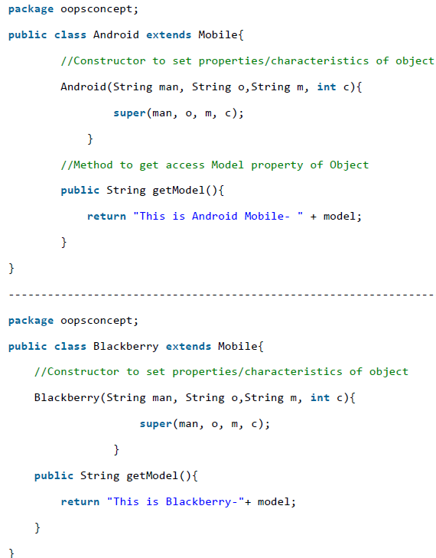
Inheritance
A class inherits state and behavior from its superclass
So you are making use of already written class and further extending on that
Benefits:
Reusability
Can implement superclasses called abstract that define “generic” behaviors

Slide 15
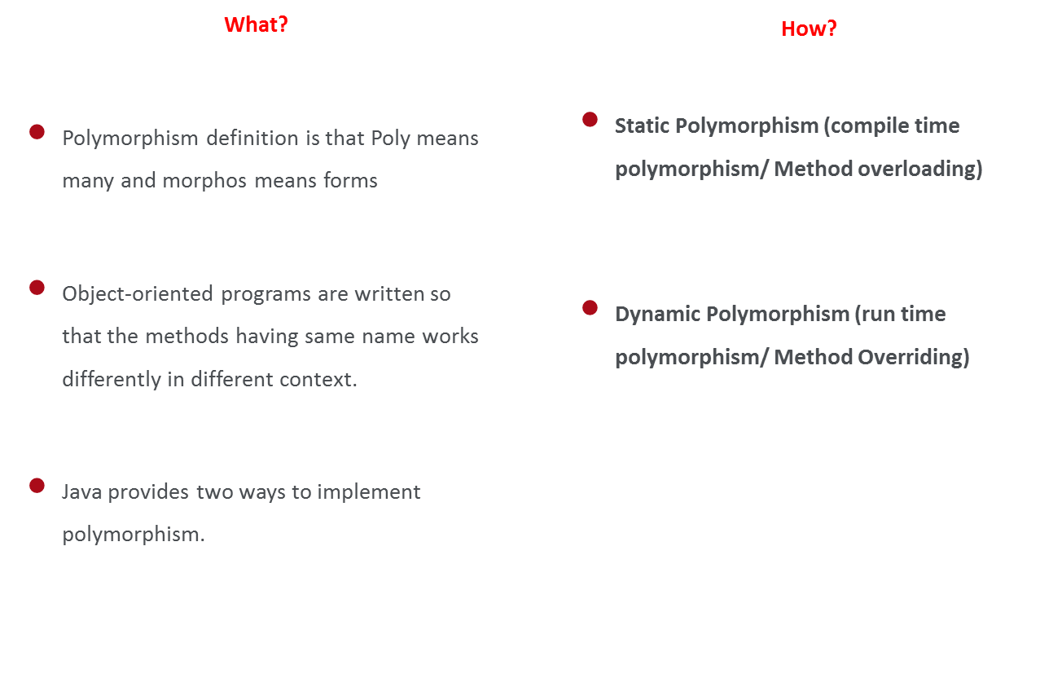
Polymorphism

Slide 16
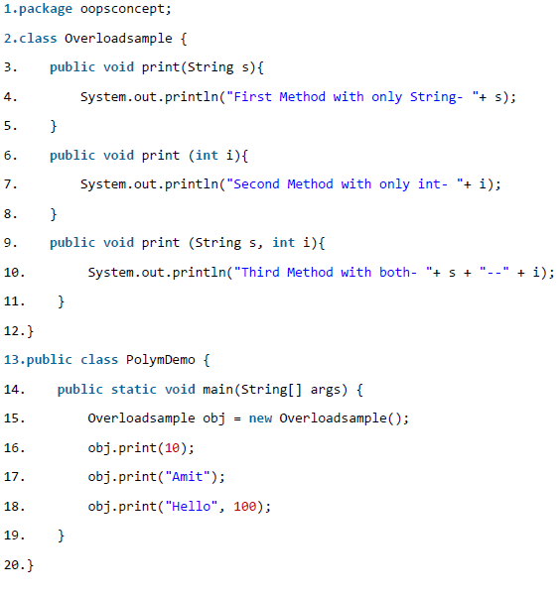
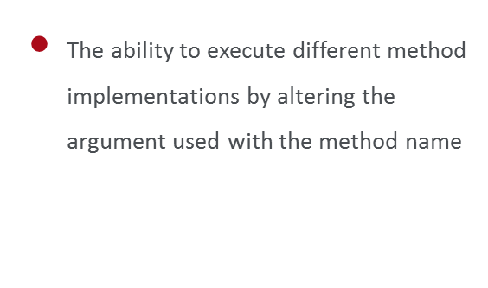
Method Overloading
Notes:
supraincarcare

Slide 17
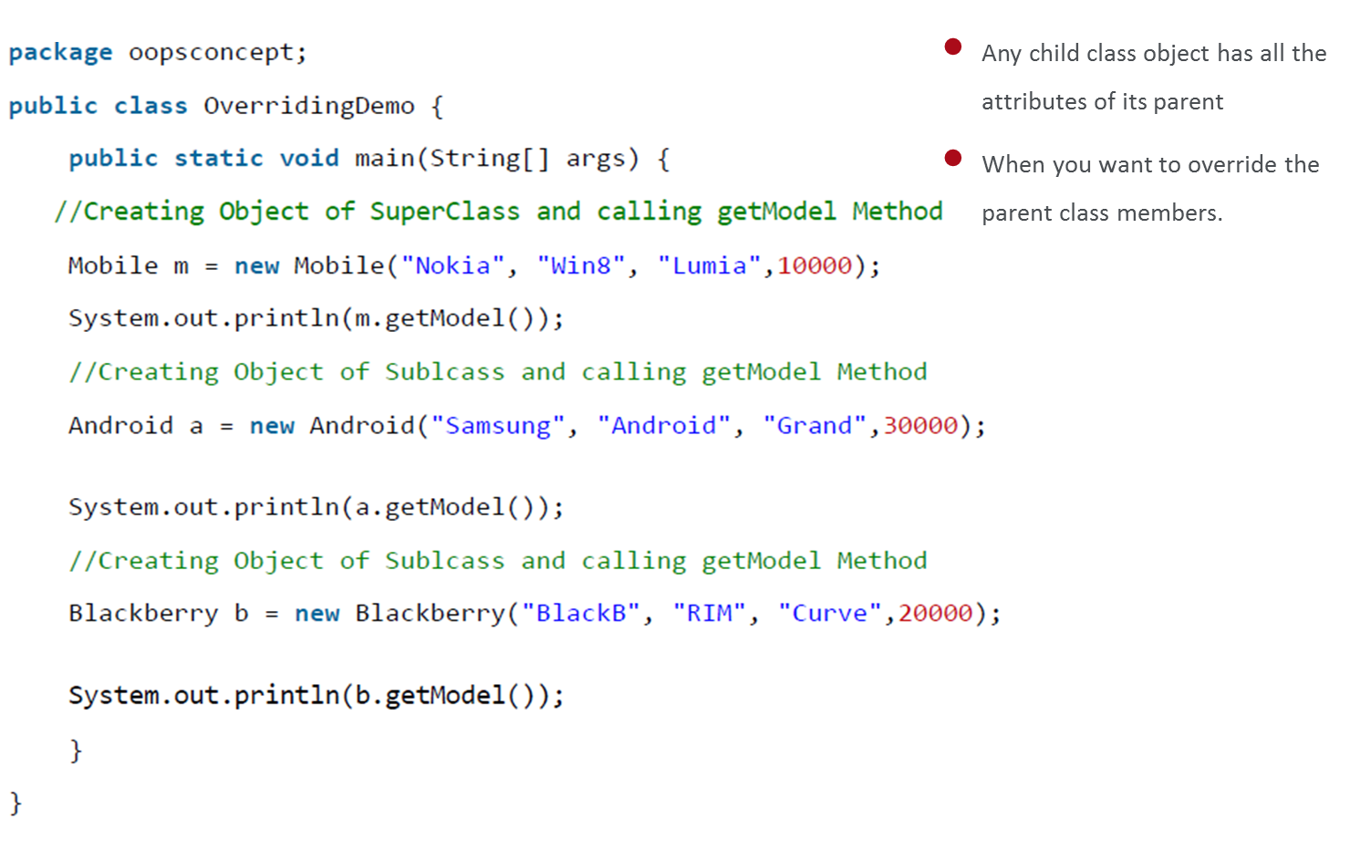
Method Overriding
Notes:
suprascriere

Slide 18
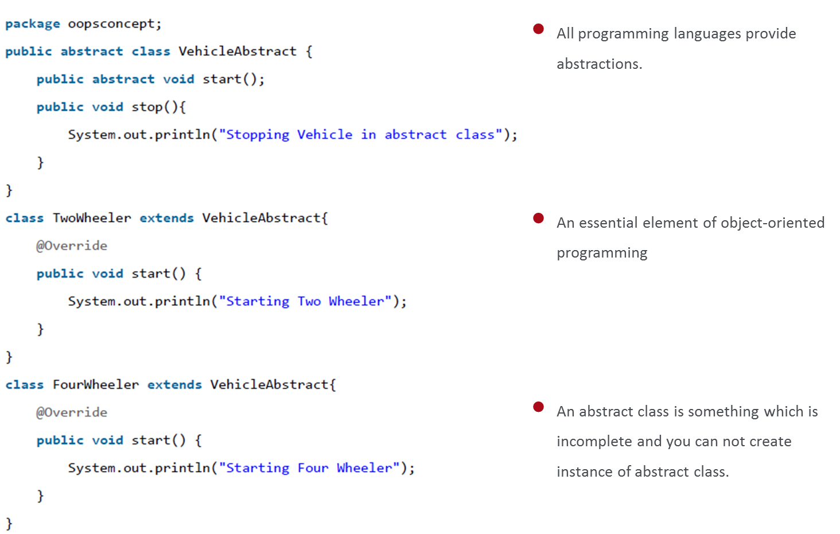
Abstraction

Slide 19
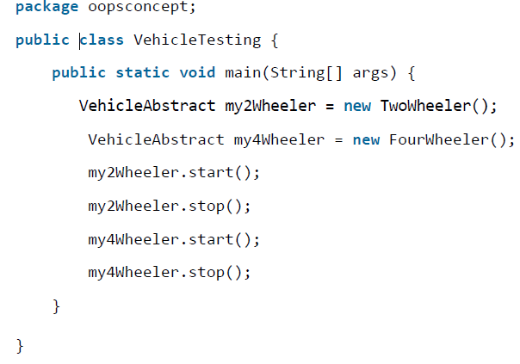
Abstraction

Slide 20
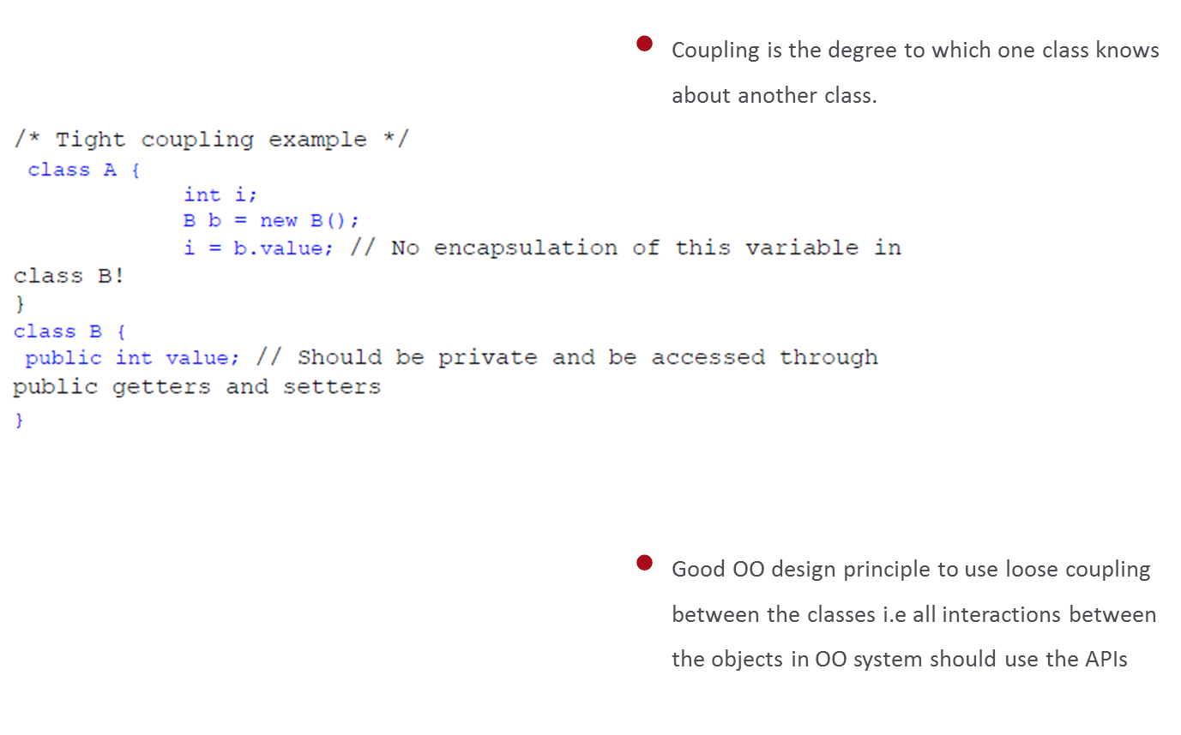
Coupling

Slide 21
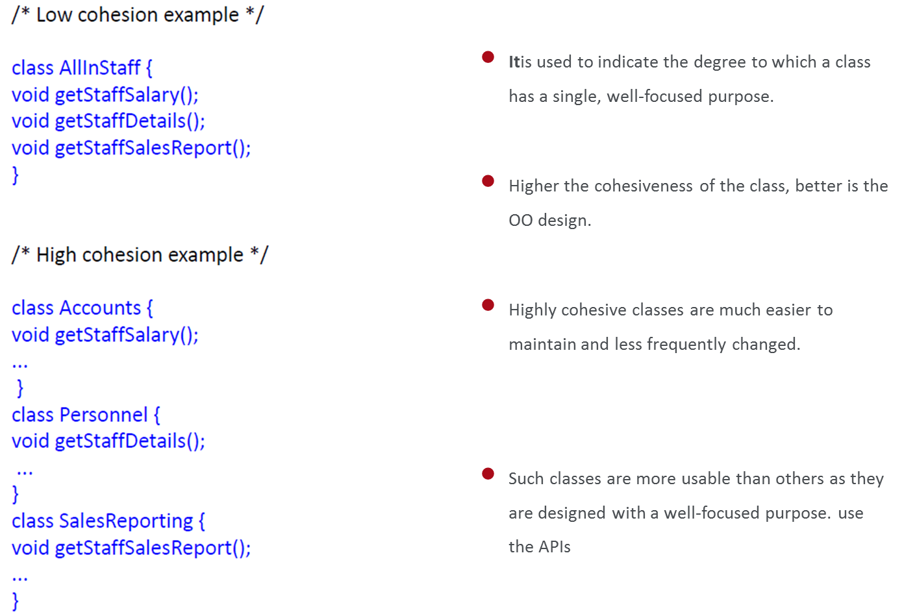
Cohesion

Slide 22
Questions?

Slide 23


Thank you! ☺
Elena Pistol
Developer
elena.pistol@endava.com
en_epistol

